Slide 1
Introduction to Programming with COBOL
NIIT Technologies Ltd

Slide 2
COBOL
COBOL is an acronym which stands for COmmon Business Oriented Language
The name indicates target area of COBOL applications
Not designed for writing system programs. One would not develop an operating system or compiler using COBOL
Standard language on most mainframe computers
COBOL is one of the oldest computer language in use (developed around end of 1950)
COBOL Implementation require program text to adhere to certain, archaic and formatting restrictions
Although modern COBOL has introduced many features to write well structured programs

Slide 3
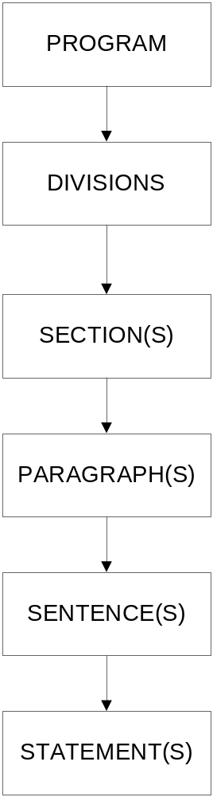
Structure Of COBOL Program

Slide 4
Struction of COBOL Program (contd..)
Character is the lowest component. (COBOL has 51 characters -> 0-9, A-Z, - + * / = $ ( ) < > . , ; “)
Word is made up of one or more characters
Statements are syntactically valid combination of words
Sentences are sequence of one or more statements terminated by a period
Paragraph consists of one or more sentences
Section consists of one or more paragraphs
Division consists of one or more paragraphs or sections
Program is made up of divisions

Slide 5
Coding a COBOL Program
COBOL Basics
Columns
COBOL Use
01-06
Sequence Number Area
07
Indicator Area
08-11
Area A
12-72
Area B
73-80
Program Designation

Slide 6
COBOL Coding Rules
07 column – Indicator area
  A hypen (-) indicates continuation of line
  An asterisk (*) indicates comment, used for documentation purposes
  A slash (/) - Compiler generates a page jump when writing striped source.
  A ‘D’ – Debugging
Area A is where the following things begin:
  Division heads
  Section heads
  Paragraph heads
  Declaratives and End Declaratives
  END PROGRAM header
  Level Indicator (FD or SD) or Level Number (01 or 77)
  COPY sentence in Data Division
Area B is where the following things begin:
  Entries, Sentences, Statements, clauses, continuation lines

Slide 7
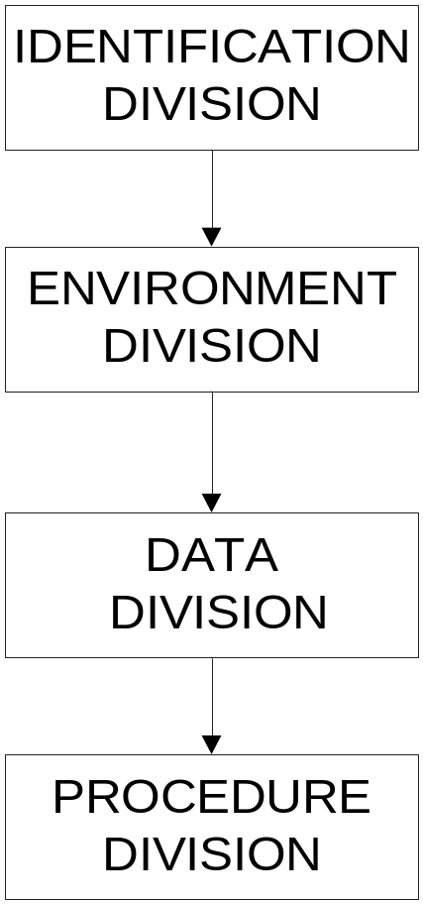
Divisions of a COBOL Program

Slide 8
OBJECTIVES
Following are the four divisions of a COBOL program
Identification Division - Identifies the program name, author, date written and date compiled.
Environment Division - Describes the computers and files associated with the program.
Data Division - Describes the details of the data used by the input and output files, and reserves memory space for the following:
  Record Layouts
  Report Lines and Headings
  Flags/Switches
  Counters and Accumulators
  Constants and Literals
  Scratch Areas

Slide 9
OBJECTIVES
Procedure Division - contains the description of algorithm which will process/manipulate the data previously described in DATA DIVISION. Like other language COBOL provides a means for specifying sequence, selection and iteration constructs

Slide 10
Functions Of Divisions
IDENTIFICATION DIVISION - Identifies the name of the program, the author of the program, the date the program was written, and the date the program was last compiled. This file is first division coded in a program, and it does not include any sections.
Code Sample 1.1: Identification Division
************************************************************
* IDENTIFICATION DIVISION *
************************************************************
IDENTIFICATION DIVISION.
PROGRAM-ID. PAYROLL.
AUTHOR. XXXXXXXX.
DATE-WRITTEN. XX/XX/XX.
DATE-COMPILED. XX/XX/XX.

Slide 11
Functions Of Divisions (Contd..)
Environment Division - Lists the computers and files that are associated with the program. This is the second division to be coded. Code Sample 1.2 shows that the Environment Division consists of two main sections, the Configuration Section and the Input-Output Section.

Slide 12
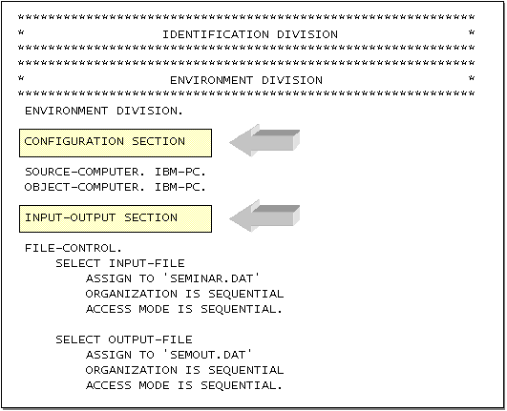
Functions Of Divisions (Contd..)
Code Sample 1.2: Environment Division

Slide 13
Functions Of Divisions (Contd..)
The Configuration Section (Code Sample 1.3) specifies the computer on which the program will be compiled (source computer) and the computer on which the program will be run (object computer).
Usually these computers are the same. Sometimes, however, the production environment and the system development environment may differ slightly. For example, some computer applications are developed on an IBM PC, but they will run on a mainframe.
This section is optional.

Slide 14
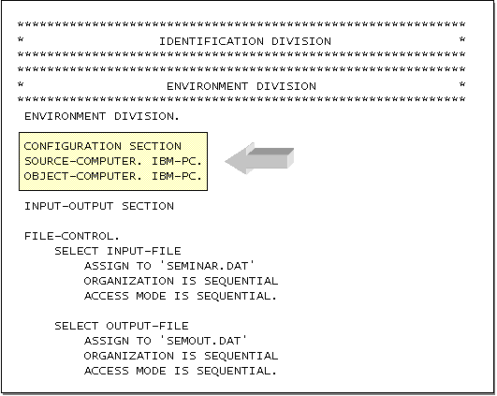
Functions Of Divisions (Contd..)
Code Sample 1.3: Configuration Section

Slide 15
Functions Of Divisions (Contd..)
The Input-Output Section - Specifies the characteristics of the files handled by the program. It defines:
    Names that the program will use to identify the files
    Where to find the files
    How data in the files will be accessed by the program
    How records are organized in the file
    The RECORD KEY of files defined as indexed
    Medium on which the files are stored
Code Sample 1.4 highlights the Input-Output Section. The names and addresses of your input and output files are listed here.

Slide 16
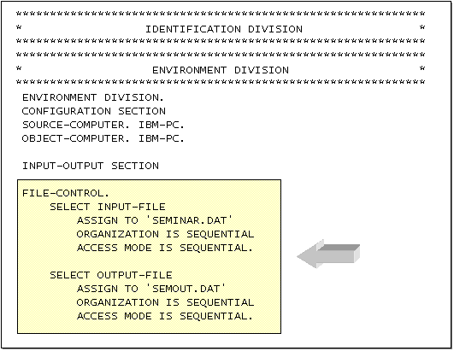
Functions Of Divisions (Contd..)
Code Sample 1.4: Input-Output Section

Slide 17
Functions Of Divisions (Contd..)
Data Division - Describes the details of the data used by the program, and it reserves memory space for this data. It has two main sections: the File Section and the Working-Storage Section
File Section - Code Sample 1.5 highlights the File Section. The File Section specifies how records are arranged within the files handled by the program. Usually, there are two components of this section–one that describes the records in the input file and another that describes the records for the output file

Slide 18
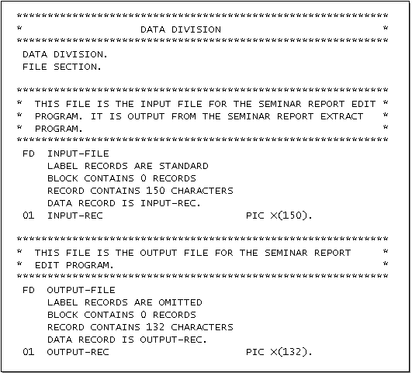
Functions Of Divisions (Contd..)
Code Sample 1.5: File Section

Slide 19
Functions Of Divisions (Contd..)
Working-Storage Section - The Working-Storage Section is a temporary internal computer memory storage area for all data processed during program execution. Data items are organized into several areas within the Working-Storage Section. Code Sample 1.6 lists the most common Working-Storage areas.

Slide 20
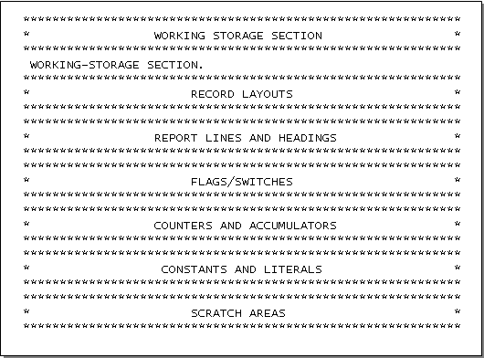
Functions Of Divisions (Contd..)
  Code Sample 1.6: Working-Storage Section

Slide 21
Functions Of Divisions (Contd..)
Procedure Division - The last division in our discussion, the Procedure Division, contains the program logic (all the necessary steps to successfully complete a task). Procedure diagrams are also used in COBOL programming to give the hierarchy and sequence of processes that take place within a program. (See Figure 1.5) The Procedure Division contains the translation of the procedure diagram (the program's logic) into COBOL code.

Slide 22
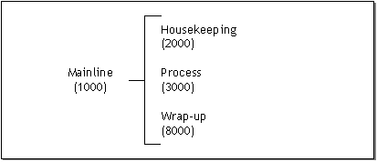
Functions Of Divisions (Contd..)
Figure 1.5: Procedure Diagram for COBOL Programming

Slide 23
COBOL Coding Rules
All user defined names such as data names, paragraph names and section names must adhere to the following rules:
  Must contain at least 1 character and not more than 30 characters
  Must contain at least one alphabetic character and must not end with hyphen
  They must be constructed from the characters ‘A’ to ‘Z’, numbers 0 to 9 and hyphen.
All data names should describe the data they contain
All paragraph and section names should describe the function they perform

Slide 24
DATA Description
3 kinds of data used in program
  Variables
  Literals
  Figurative constants
Elementary data items are specified using PICTURE clause in DATA DIVISION
PIC and PICTURE are equivalent
Data Names must be described in terms of their type and size using PIC clause
01 EMP-NAME PIC X(20).

Slide 25
COBOL DATA TYPES
Group Items are in ALPHANUMERIC class regardless of sub-ordinate items
Elementary items are determined by their definition (PIC clause):
  9 (digit nine) is used to denote Numeric item and indicates occurrence of a digit at the corresponding position in the picture
  A (character A) is used to denote Alphabetic item and indicates occurrence of a character at the corresponding position in the picture
  X (character X) is used to denote alphanumeric item and indicates occurrence of a alphabet or a number at the corresponding position in the picture
  V (character V) is used to store assumed decimal point in a numeric item
  S (character S) is used to indicate the presence of sign and can only appear at the beginning of PIC clause

Slide 26
COBOL ‘PIC’ Clause
PIC 999 - A three digit (+ve only) integer
PIC S999 - A three digit (+ve or -ve) integer
PIC XXXX – A four character text item or string
PIC 99V99 – A Positive real integer in the range of 0 to 99.99
Numeric Values can have maximum 18 digits
Recurring symbols can be specified using ‘repeat’ factor inside round brackets. Viz. PIC XXXX and PIC X(4) are equivalent

Slide 27
DATA DECLARATION
In COBOL data declaration consists of a line containing following items:
  A Level Number
  A data-name or identifier
  PIC clause
  Value clause (Optional)
  01 EMP-NAME PIC X(40).
  01 EMP-PF PIC V99 VALUE .12.
Value Clause assigns starting value to variable by extension to PIC clause, not for items whose size is variable, value of item should not exceed the PIC Size.

Slide 28
COBOL LITERALS
String/Alphanumeric literals are enclosed in quotes and may consist of alphanumeric characters
  “ NIIT”, “123.45”, “BA 132”
Numeric Literals may consist of numerals, decimal point and plus or minus sign. It is not enclosed in quotes
  123.45, -2543, + 956.45

Slide 29
FIGURATIVE CONSTANTS
ZERO, ZEROS, ZEROS - 0
SPACE, SPACES -
QUOTE, QUOTES - “
HIGH-VALUE, HIGH-VALUES - max value
LOW-VALUE, LOW-VALUES - min value
ALL literal - fill with literal
Singular and Plural forms of figurative constants can be used
interchangeably

Slide 30
GROUP ITEMS/RECORDS
01 EMPLOYEE-RECORD.
05 EMPLOYEE-NAME.
10 FIRST-NAME PIC X(20).
10 MIDDLE-NAME PIC X(20).
10 SURNAME PIC X(15).
05 EMPLOYEE-BIRTH-DATE.
10 BIRTH-DATE PIC 9(2).
10 BIRTH-MONTH PIC 9(2).
10 BIRTH-YEAR PIC 9(4).
05 EMPLOYEE-DEPT PIC X(4).
05 EMPLOYEE-JOB-TITLE PIC X(2).
05 EMPLOYEE-GROSS-PAY PIC 9(6).

Slide 31
LEVEL NUMBERS IN HIERARCHY
Level Numbers are used to break up structure into constituent parts and describe data hierarchy
A level is a 2-digit number. 01-49 are general level numbers and 66,77 and 88 are special level numbers
Level numbers need not be consecutive
Group Items is used to describe the items that have been further divided. It is declared using level number and data name. It can not have PIC clause. e.g. EMPLOYEE-NAME, EMPLOYEE-BIRTH-DATE. Where a group item is highest in hierarchy at level 01, it is referred to as RECORD.
Elementary Item is used to describe at lowest level which is not further divided. It is declared using level number, data name and PIC clause. e.g. BIRTH-DATE, BIRTH-MONTH, BIRTH-YEAR.

Slide 32
SPECIAL LEVEL NUMBERS
LEVEL-66 contains a RENAME clause. It regroups previously defined items.
LEVEL-77 defines ELEMENTARY items with no subdivision and are unique
LEVEL-88 establishes condition-name entries, associated with a VALUE clause
Example:
01 EMPLOYEE-RECORD.
05 EMPLOYEE-TYPE PIC X.
88 PERMANENT VALUE ‘P’
88 TEMPARARY VALUE ‘T’

Slide 33
SPECIAL LEVEL NUMBERS (Contd..)
05 EMPLOYEE-NAME PIC X(30).
05 EMPLOYEE-ADDRESS.
10 STREET PIC X(15).
10 CITY PIC X(15).
10 STATE PIC X(2).
10 ZIP-CODE PIC X(6).
66 GEOGRAPHIC RENAMES CITY THRU ZIP-CODE.
…..
77 COUNTER PIC S9(5)

Slide 34
FILLER
FILLER is a COBOL reserved word used to describe data fields that will not be referenced in the PROCEDURE DIVISION
If the data-name or FILLER clause is omitted, the data item being described is treated as though it was filler
Example:
01 EMPLOYEE-RECORD.
05 EMPLOYYE-TYPE PIC X.
05 EMPLOYEE-NAME PIC X(30).
05 EMPLOYEE-ADDR PIC X(35).
05 FILLER PIC X(24).

Slide 35
COBOL Metalanguage – Syntax Notation
Words in Uppercase are reserved words
  When Underlined they must be present when the operation of which they are a part is used
  When they are not underlined it is used for readability only and are optional. If used they must be spelt correctly
Words in mixed case represent names which will be devised by programmer
When material is enclosed in braces {}, a choice must be made from the options within the braces
When material is enclosed in [], indicates an option which may be included or omitted as required
The ellipsis symbol ‘..’ indicates that the preceding syntax element may be repeated

Slide 36
MOVE Verb
MOVE {Identifier / Literal} TO {Identifier} ..
MOVE copies data from source identifier or literal to destination identifier and contents of destination items are completely replaced
Source and Destination identifier can be group or elementary items
When destination item is alphabetic or alphanumeric (X or A) then data is copied into destination area from left to right with space filling or truncation on right.
When destination item is Numeric (9) or Edited Numeric then data is aligned along the decimal point with zero filling or truncation as necessary
MOVE CORRESPONDING is used to move the same name data items from one group variable to another
e.g. MOVE 0.12 TO PF-RATE
MOVE ‘NIIT’ TO COMPANY-NAME

Slide 37
INITIALISE Statement
INITIALISE statement sets SPACE for alphabetic, alphanumeric and alphanumeric- edited items
INITIALISE statement sets ZERO for numeric and numeric-edited items
It is functionally equivalent to one or more MOVE statements
It is generally used without REPLACING phrase
INITIALISE data-item/s
e.g. INITIALISE WS-EMP-COUNT
EMP-GROSS-PAY

Slide 38

DISPLAY Verb
A simple DISPLAY statement is used to display messages and data on screen
A single DISPLAY statement can be used to display several data items or literals or any combination of this
WITH NO ADVANCING clause suppresses the carriage return/line feed

Slide 39
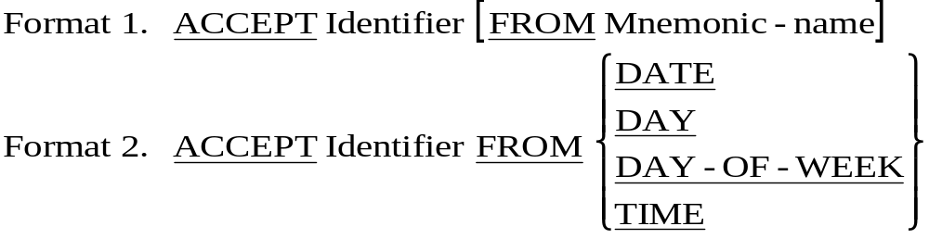
ACCEPT Verb
01 CurrentDate PIC 9(6). * YYMMDD
01 DayOfYear PIC 9(5). * YYDDD
01 DayOfWeek PIC 9. * D (1=Monday)
01 CurrentTime PIC 9(8). * HHMMSSss

Slide 40
USAGE CLAUSE
USAGE clause specifies the format of data item in computer storage
When USAGE clause is not specified at either the group or elementary level, it is assumed USAGE is display (one character for each 8-bit byte)
USAGE COMP/Binary – Data is stored in binary form
  When signed, negative values are represented in 2’s complement form of absolute number
  A halfword (2 byte) is used for 1-4 digits

Slide 41
USAGE CLAUSE
  A fullword (4 byte) is used for 5-9 digits
  A doubleword (8 bytes) for 10-18 digits
  e.x. S9(4) COMP declaration of data item will take 2 bytes of storage
USAGE COMP-3 – Data is stored internally in packed decimal format
  i.e. 2 digits per byte, except for the right-most byte which holds one digit and the sign of the field.
  e.g S9(9) COMP-3 declaration of data item will take 5 bytes of storage

Slide 42
COPY Verb
COPY statement allows program to include frequently used source code text from a copy library
While other COBOL statements are executed at run time, COPY statements are executed at compile time
It allows items descriptions to be kept and updated centrally in a copy library and provides ease of implementation and maintenance
Each client program wants to use items described in copy library uses the COPY verb to include description it requires

